Slide 1
Decision tree learning
  Machine Learning, Tom Mitchell
  Mc Graw-Hill International Editions, 1997
  (Cap 3).

Slide 2
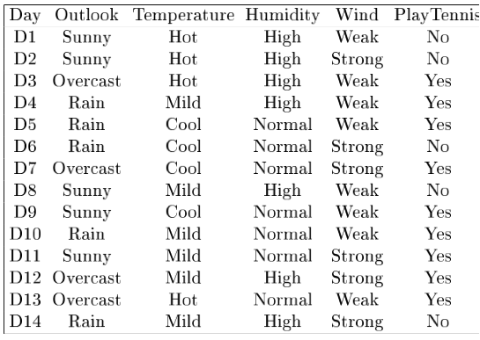
Example
Notes:
Target attrbute = playtennis

Slide 3
Entropy in binary classification
Entropy measures the impurity of a collection of examples. It depends from the distribution of the random variable p.
  S is a collection of training examples
  p₊ the proportion of positive examples in S
  p– the proportion of negative examples in S
Entropy (S) ≡ – p₊ log₂ p₊ – p–log₂ p– [0 log₂0 = 0]
Entropy ([14+, 0–]) = – 14/14 log₂ (14/14) – 0 log₂ (0) = 0
Entropy ([9+, 5–]) = – 9/14 log₂ (9/14) – 5/14 log₂ (5/14) = 0.94
Entropy ([7+, 7– ]) = – 7/14 log₂ (7/14) – 7/14 log₂ (7/14) =
= 1/2 + 1/2 = 1 [log₂1/2 = – 1]
Note: the log of a number < 1 is negative, 0 ≤ p ≤ 1, 0 ≤ entropy ≤ 1
Notes:
S=[9+, 5-] una collezione di esempi di cui 9 positivi e 5 negativi

Slide 4
Entropy in general
Entropy measures the amount of information in a random variable
H(X) = – p₊ log₂ p₊ – p– log₂ p– X = {+, –}
for binary classification [two-valued random variable]
c c
H(X) = – Σ p_{i} log₂ p_{i} = Σ p_{i} log₂ 1/ p_{i} X = {i, …, c}
i=1 i=1
for classification in c classes
Example: rolling a die with 8, equally probable, sides
8
H(X) = – Σ 1/8 log₂ 1/8 = – log₂ 1/8 = log₂ 8 = 3
i=1

Slide 5
Entropy and information theory
Entropy specifies the number the average length (in bits) of the message needed to transmit the outcome of a random variable. This depends on the probability distribution.
Optimal length code assigns ⎡− log₂ p⎤ bits to messages with probability p. Most probable messages get shorter codes.
Example: 8-sided [unbalanced] die
1 2 3 4 5 6 7 8
4/16 4/16 2/16 2/16 1/16 1/16 1/16 1/16
2 bits 2 bits 3 bits 3 bits 4bits 4bits 4bits 4bits
E = (1/4 log₂ 4) × 2 + (1/8 log₂ 8) × 2 + (1/16 log₂ 16) × 4 = 1+3/4+1 = 2.75

Slide 6
Information gain as entropy reduction
Information gain is the expected reduction in entropy caused by partitioning the examples on an attribute.
The higher the information gain the more effective the attribute in classifying training data.
Expected reduction in entropy knowing A
Gain(S, A) = Entropy(S) − Σ Entropy(Sv)
v ∈ Values(A)
Values(A) possible values for A
Sv subset of S for which A has value v
|Sv|
|S|
Notes:
La riduzione in entropia attesa partizionando sui valori dell’ attributo A

Slide 7
Example: expected information gain
Let
  Values(Wind) = {Weak, Strong}
  S = [9+, 5−]
  S_{Weak} = [6+, 2−]
  S_{Strong} = [3+, 3−]
Information gain due to knowing Wind:
  Gain(S, Wind) = Entropy(S) − 8/14 Entropy(S_{Weak}) − 6/14 Entropy(S_{Strong})
  = 0.94 − 8/14 × 0.811 − 6/14 × 1.00
  = 0.048

Slide 8
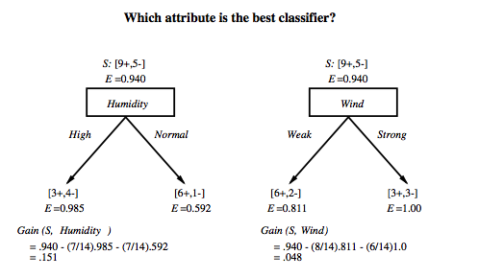
Which attribute is the best classifier?

Slide 9
First step: which attribute to test at the root?
Which attribute should be tested at the root?
  Gain(S, Outlook) = 0.246
  Gain(S, Humidity) = 0.151
  Gain(S, Wind) = 0.084
  Gain(S, Temperature) = 0.029
Outlook provides the best prediction for the target
Lets grow the tree:
  add to the tree a successor for each possible value of Outlook
  partition the training samples according to the value of Outlook

Slide 10
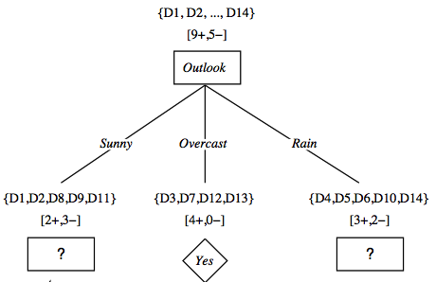
After first step

Slide 11
Second step
Working on Outlook=Sunny node:
  Gain(S_{Sunny}, Humidity) = 0.970 − 3/5 × 0.0 − 2/5 × 0.0 = 0.970
  Gain(S_{Sunny}, Wind) = 0.970 − 2/5 × 1.0 − 3.5 × 0.918 = 0.019
  Gain(S_{Sunny}, Temp.) = 0.970 − 2/5 × 0.0 − 2/5 × 1.0 − 1/5 × 0.0 = 0.570
Humidity provides the best prediction for the target
Lets grow the tree:
  add to the tree a successor for each possible value of Humidity
  partition the training samples according to the value of Humidity

Slide 12
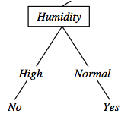
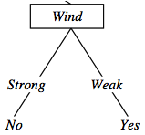
Second and third steps
{D1, D2, D8}
No
{D9, D11}
Yes
{D6, D14}
No
{D4, D5, D10}
Yes

Slide 13
ID3: algorithm
ID3(X, T, Attrs) X: training examples:
T: target attribute (e.g. PlayTennis),
Attrs: other attributes, initially all attributes
Create Root node
If all X's are +, return Root with class +
If all X's are –, return Root with class –
If Attrs is empty return Root with class most common value of T in X
else
A ← best attribute; decision attribute for Root ← A
For each possible value v_{i} of A:
- add a new branch below Root, for test A = v_{i}
- X_{i} ← subset of X with A = v_{i}
- If X_{i} is empty then add a new leaf with class the most common value of T in X
else add the subtree generated by ID3(X_{i}, T, Attrs − {A})
return Root

